Slide 1

Customer ABC
Implementation Plan
Date: XX/XX/XXX

Slide 2

Meeting Objective
Review Product Purchase/Modules & Services
5 Step Implementation Process
  Kick-off
  Planning
  Testing & Refine
  Deploy
  Support
Timeline Expectations
Success Criteria
Open Q & A

Slide 3
#1
Kick-off
#2
Plan
#3
Test & Refine
#4
Deploy
#5
Support
Implementation 5 Step Process
Communication Training Consultation Excellence

Slide 4
Implementation Process
  Review project methodology
  Review Customer ABC’s product purchase / modules & services
  Discuss joint accountabilities
  Success criteria
  Timeline
  Distribute documentation /artifacts
  Agree on next step
#1
Kick-Off
Communication Training Consultation Excellence

Slide 5
Implementation Process
  Identify project team
  Gather technical specifications
    User log-in’s, server credentials, etc.
  Install test instance
  Load data into environment
  High level testing of core functionality
#2
Planning
Communication Training Consultation Excellence

Slide 6
Implementation Process
  Deliver webinar / demo
  Review test plan expectations
  Review testing timeline
  Test functionality
  Identify reporting needs
  Weekly check-in’s
  Submit issues to READYSupport Team via Zendesk
  Resolve issues and retest
  Reports developed and reviewed
  Additional training as needed
  Deployment planning
#3
Test, Refine & Repeat
Communication Training Consultation Excellence

Slide 7
Implementation Process
  Go-live with new version
  In heavy support mode
  Monitor issue submission
  Resolve issues
  Stabilize & optimize
  Onsite support if needed
#4
Deploy
Communication Training Consultation Excellence

Slide 8
Implementation Process
  Hand-off to READYSupport Team
  Review expectations on SLA’s
  Review escalation path
  Ongoing software release process
#5
Support
Communication Training Consultation Excellence

Slide 9
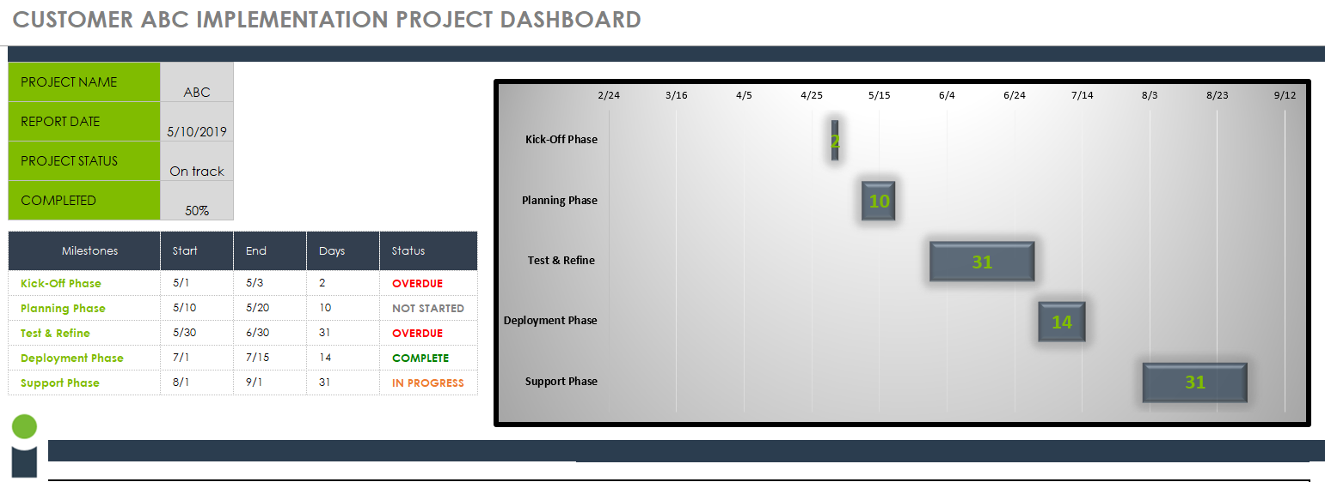
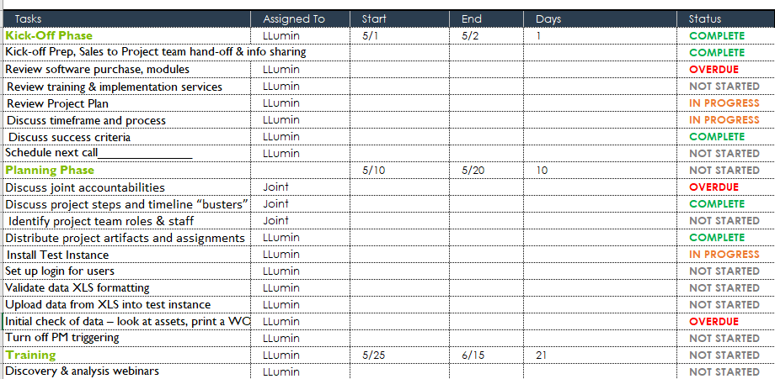
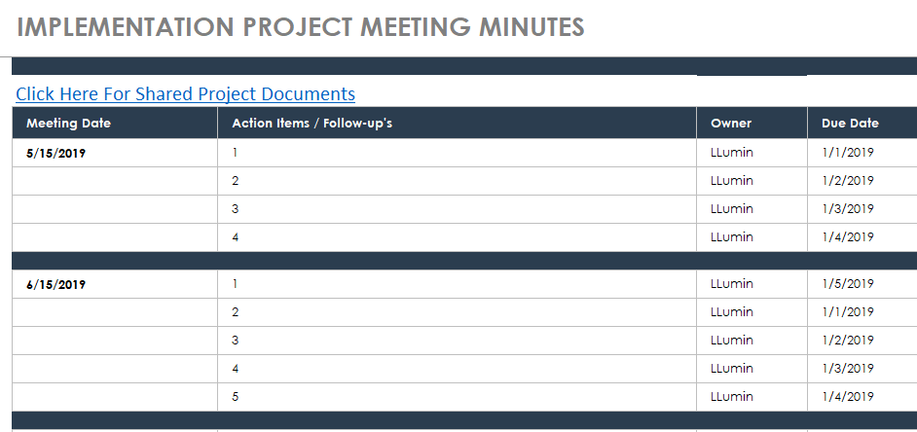

Slide 10
  Communication Plan
  Weekly email check-in
    Project status
    Issue list review
    Action items / follow-up’s
  Bi-weekly calls
    Review project status
    Review issue list
    Escalate issues
    Review timelines

Slide 11
Next Steps
Discuss timeline expectations
Schedule training / webinars
Schedule meeting series
Discuss detailed next steps…….

